Slide 1
OLYMPICS DATASET ANALYSIS
CREATED BY: ANAMIKA M NAMBIAR

Slide 2
ABOUT THE DATASET
Time Period: Covers Olympic events from 1896 to 2016 for both Summer and Winter Games.
Scope: Contains medal records for athletes, sports, years, and countries. It allows for a deep analysis of performance by countries, sports, and gender.
Data Size: The dataset contains thousands of records on medal winners from 1896 to 2016, making it a comprehensive source for analysis.

Slide 3
PROBLEM STATEMENT
Analyse the dataset and review the following problem statements.
Medals won by gender(%).
Male and Female ratios by year.
Top 10 countries by medal.
Top olympic medallists by total medal.
Top 10 sports by gender.
Summer vs Winter olympics comparison by medal count.
Total number of Sports.
Total number of Events.
Total number of Medal-Winning Countries.
Total number of Participating countries.

Slide 4
TOOLS USED FOR ANALYSIS
EXCEL: Used for data cleaning, removal of null values, and initial exploration.
TABLEAU: Used to create dynamic, interactive charts for country performance, gender comparison, and medal analysis.

Slide 5
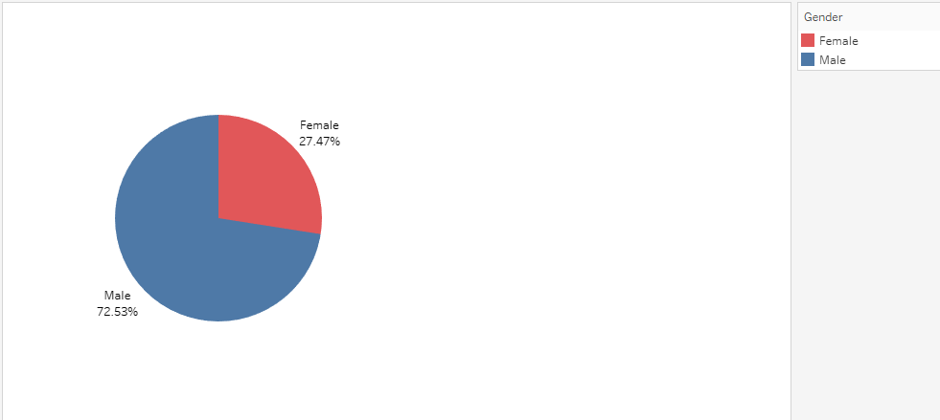

Medals won by gender(%)
This pie chart illustrates the gender distribution of our dataset.
The chart reveals a significant gender imbalance, with males representing 72.53% and females comprising 27.47%.
We need to consider strategies to attract and engage more female participants.

Slide 6
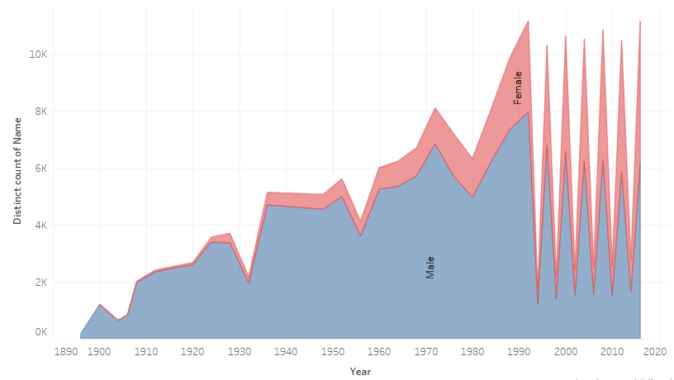
Male and Female ratios by year.
Notes:
Female participation increased significantly from 1992 to 2016, reflecting gender parity initiatives in Olympic sports.

Slide 7
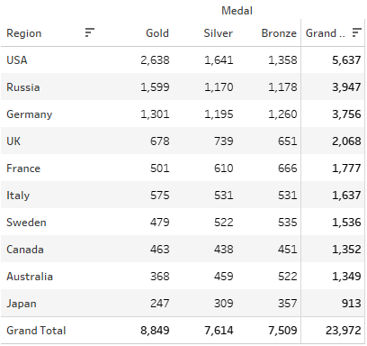
Top 10 countries by medal.
The USA dominates the Olympic medal count, followed by Russia and Germany.
These countries have strong sports development programs and a legacy of participation.
Smaller countries like Sweden, Canada, and Australia have achieved remarkable success relative to their population size.

Slide 8
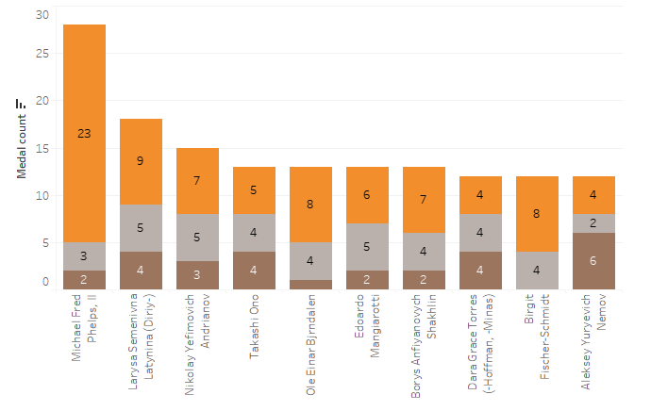

Top olympic medallists by total medal.
Notes:
Michael Phelps is the most decorated Olympian with 28 medals, dominating swimming events from 2004 to 2016.

Slide 9
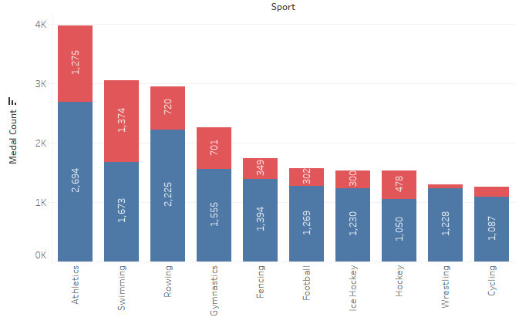

Top 10 sports by gender.
Notes:
Sports like Gymnastics and Swimming have more female medalists, while Athletics is dominated by male participants

Slide 10
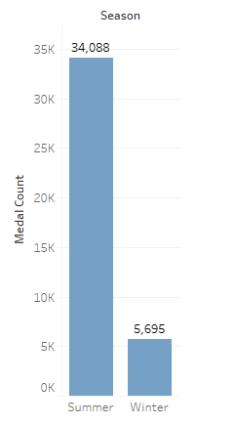
Summer vs Winter olympics comparison by medal
The popularity and scale of Summer Olympic sports contribute to the higher number of medals.
The nature of Winter sports, with fewer participants and events, results in fewer medals awarded.
This disparity highlights the difference in resources and attention given to Summer and Winter sports.
Notes:
Summer Olympics feature more sports, resulting in higher medal counts than Winter Olympics.

Slide 11
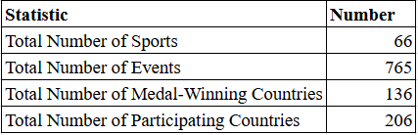
Other statistics
The Olympic Games featured a total of 66 sports and 765 events.
A remarkable 136 countries claimed medals in these games.
The total number of participating countries reached 206, showcasing global unity and athleticism.

Slide 12
GENERAL CONCLUSIONS
🌍 Global Participation: 206 countries participate, promoting global unity.
📈 Diverse Sports Program: More sports are added to attract diverse participants.
🥇 Dominant Countries: The USA, Russia, and Germany are dominant medal-winners.
🏋️‍♀️ Gender Disparity: Women win 27% of medals but participation is growing.
🌞 Summer vs Winter: Summer Olympics award significantly more medals than Winter.

Slide 13
Potential Areas for Further Analysis
Impact of Hosting the Olympics: Analyze the impact of hosting the Olympics on a country's medal count and overall economic and social development.
Factors Contributing to Success: Investigate the factors that contribute to the success of top-performing countries and athletes, such as training methods, infrastructure, and government support.
Emerging Trends: Identify emerging trends in the Olympic movement, such as the increasing participation of women and the rise of new sports.
Social and Cultural Impact: Explore the social and cultural impact of the Olympics, including its role in promoting international understanding and peace.

Slide 14
REFERENCE
Dataset : https://github.com/TheiScale

Slide 15
THANK YOU

